Slide 1
Elimination Tournament
Round 1
4th Annual WSMA Math Bowl
March 29, 2014
This test material is copyright © 2014 by the Washington Student Math Association and may not be distributed or reproduced other than for nonprofit educational purposes without the expressed written permission of WSMA. www.wastudentmath.org.

Slide 2
Problem 1
What is the length of the largest side in the smallest non-degenerate triangle, by area, that has distinct integral side lengths?
Copyright © 2014 by the Washington Student Math Association

Slide 3
Problem 2
What is the product of the first 4 triangular numbers?
Copyright © 2014 by the Washington Student Math Association

Slide 4
Problem 3
It is 20 past 4. What is the angle formed by the minute and hour hand?
Copyright © 2014 by the Washington Student Math Association

Slide 5
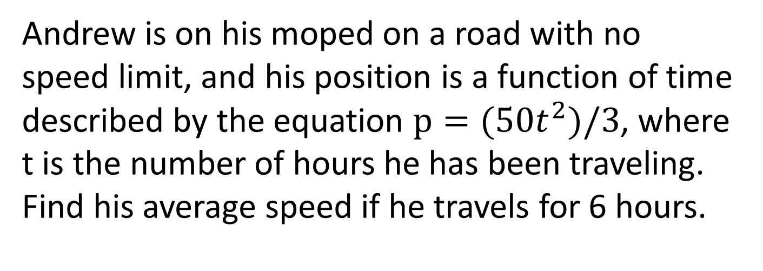
Problem 4
Andrew is on his moped on a road with no speed limit, and his position is a function of time described by the equation $p=(50t^{2})/3$, where t is the number of hours he has been traveling. Find his average speed if he travels for 6 hours.
Copyright © 2014 by the Washington Student Math Association

Slide 6
Problem 5
What is the median of the following set: {0, pi, 3, 3.14, 3.1415, 3.141592}?
Copyright © 2015 by the Washington Student Math Association

Slide 7
Problem 6
Given 4 lines on a plane, what is the maximum number of intersections that can be made?
Copyright © 2014 by the Washington Student Math Association

Slide 8
Problem 7
What is the sum of all the composite factors of 24?
Copyright © 2014 by the Washington Student Math Association

Slide 9
Extra Question
What is the positive difference in length between the longest line that can fit in a 1 inch by 1 inch by 1 inch cube and the longest line that can fit in a 1 inch by 1 inch square?
Copyright © 2014 by the Washington Student Math Association

