Slide 1
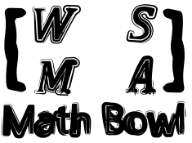
Elimination Finals
1st Annual WSMA Math Bowl
May 27, 2011

Slide 2
Problem 1
What is the area of the region in the coordinate plane described by $|x+y|≤4$ and $\left|x−y\right|≤4$that does not include the region described by $|x+y|≤2$?

Slide 3
Problem 2
Find the value or values of $x$ that satisfy the following inequality:
$$x^{2}−x+1≤x^{2}+x+17≤2x^{2}+x+1$$

Slide 4
Problem 3
If $r=\frac{x}{y}$ and${ r}^{2}+2r−1=0$, express $y^{4}−12x^{3}y$ in terms of $x$ only.

Slide 5
Problem 4
The parabolas $y=x^{2}−4x+4$ and $y=−x^{2}+4x+4$ intersect at points A and B. Similarly, the curves $y=x^{2}+8x+5$ and $y=−x^{2}−8x−9$ intersect at points C and D. What is the area of the trapezoid formed by the four points A, B, C, and D?

Slide 6
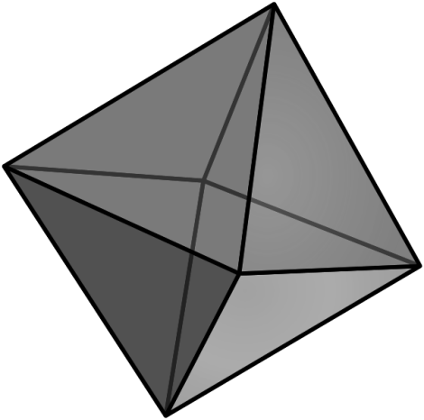
Problem 5
Find the volume of a regular octahedron with side length 2.

Slide 7
Problem 6
Find the sum of the following infinite series:
$$1−\frac{1}{2}−\frac{1}{4}+\frac{1}{8}−\frac{1}{16}−\frac{1}{32}+\frac{1}{64}−\frac{1}{128}⋯$$

Slide 8
Problem 7
Compute the absolute value of the difference between the repeating decimal $0.45454545…$ and $0.45$.

Slide 9
Problem 8
Find the period of
$f(x)=\sin{5x}+\cos{19x}$.

Slide 10
Problem 9
What is the smallest possible area of a right triangle whose side lengths are all composite numbers?

Slide 11
Problem 10
What is the third-smallest positive integer with exactly eight positive integer factors?

Slide 12
Problem 11
How many pairs of prime numbers less than 100 are there such that the sum of the two numbers in the pair is another prime number?

Slide 13
Problem 12
Suppose $5a^{2}+8ab+5b^{2}=6$ and $3a+3b=4$. What is the value of $2a^{2}+5ab+2b^{2}$?

Slide 14
Problem 13
Suppose the world is a cube, and the furthest distance between two cities on the same face is 20 units. What is the minimum volume of the world, in units cubed?

Slide 15
Problem 14
The sides of a trapezoid have lengths $x$, $x$, $x$, and $2x$. What is the measure of the greatest angle in the trapezoid, in degrees?

Slide 16
Problem 15
Quadrilateral $ABCD$ has midpoints $M$ on $AB$, $N$ on $BC$, $O$ on $CD$, and $P$ on $DA$. If M is located at $(0, 0)$, N at $(5, 0)$, and P at $(0, 5)$, what are the coordinates of point $O$?

Slide 17
Problem 16
The product of $R$ and 7 more than $R$ is -12. What is the sum of the reciprocals of all possible values of $R$?

Slide 18
Problem 17
52 cards in a standard deck are dealt out randomly to the 25 Mariners and Ichiro’s dog such that each is given a pair of cards. What is the probability that Felix Hernandez is dealt both a king and an ace?

Slide 19
Problem 18
Each vertex of a pentagon is assigned a nonnegative integer value so that the positive difference between the values at any two adjacent vertices is no greater than 2. How many ways are there to assign these five values if the sum of the values is 5? Two assignments are considered the same if one can be rotated to produce the other.

Slide 20
Problem 19
A cylindrical container 16 units high and 6 units in diameter is partially filled with water. The cylinder is tilted so that the water level reaches 11 units up the side of the cylinder at the highest but only 5 units up at the lowest. Compute the volume of water in the cylinder.

Slide 21
Problem 20
If$x^{4}−4x^{3}+6x^{2}−4x+1=\frac{4}{3}\log_{2}{4096}$, compute the greatest positive real value of $x$.

Slide 22
Problem 21
Let $N$ be an integer such that the product $41×43×N$ can be written as the sum of 6 consecutive positive integers. Compute the least possible value for the smallest of the 6 integers.

Slide 23
Problem 22
Compute the ratio of the volume of a sphere to the volume of the largest regular octahedron that will fit inside it.

Slide 24
Problem 23
What is the greatest possible diameter of a circle centered at $(0, 0)$ that does not intersect the graph of $y = \frac{8}{x}$ at more than two points?

Slide 25
Problem 24
Evaluate $\frac{1}{\sqrt{11}+\sqrt{10}}+\frac{1}{\sqrt{10}+\sqrt{9}}+\frac{1}{\sqrt{9}+2\sqrt{2}}+…+\frac{1}{\sqrt{2}+1}$.

Slide 26
Problem 25
The bases of a trapezoid have lengths 10 and 21, and the legs have lengths $\sqrt{34}$ and $3\sqrt{5}$ . What is the area of the trapezoid? Express your answer as a fraction in simplest form.

Slide 27
Problem 26
Evaluate the sum: $1+\frac{1}{4}+\frac{1}{9}+\frac{1}{16}+\frac{1}{25}+\frac{1}{36}⋯$

Slide 28
Problem 27
Find the volume of the solid formed by revolving an ellipse with semimajor axis of length 3 and semiminor axis of length 2 about its semimajor axis.

Slide 29
Well Done!
Thank you for participating!

