Slide 1

Preliminary Round 2
1st Annual WSMA Math Bowl
May 27, 2011

Slide 2
Problem 1
The first term of a sequence is 2011. Each succeeding term is the sum of the cubes of the digits of the previous terms. What is the 2011th term of the sequence?

Slide 3
Problem 2
Jocelyn drove her compact car 120 miles home for the weekend and averaged 30 miles per gallon. On the return trip she drove her parents' sedan and averaged only 20 miles per gallon. What was the average gas mileage, in miles per gallon, for the round trip?

Slide 4
Problem 3
Charles’s house has 3 bedrooms. Each bedroom is 15 feet long, 12 feet wide, and 8 feet high. Charles must paint the walls of all the bedrooms. Doorways and windows, which will not be painted, occupy 60 square feet in each bedroom. How many square feet of walls must be painted?

Slide 5
Problem 4
[Problem 4 was thrown out.]

Slide 6
Problem 5
Find the length of the longest altitude in a triangle with side lengths 13, 14, and 15.

Slide 7

Problem 6
If the sum of an infinite geometric series is 4, what is the common ratio, $r$, given that $1/r$ equals the first term of the series?

Slide 8
Problem 7
Chris and Christina each bought 12 ounces of coffee in a 16-ounce cup. Chris drank 2 ounces of his coffee and then added 2 ounces of cream. Christina added 2 ounces of cream, stirred the coffee well, and then drank 2 ounces. What is the resulting ratio of the amount of cream in Chris’s coffee to that in Christina’s coffee?

Slide 9
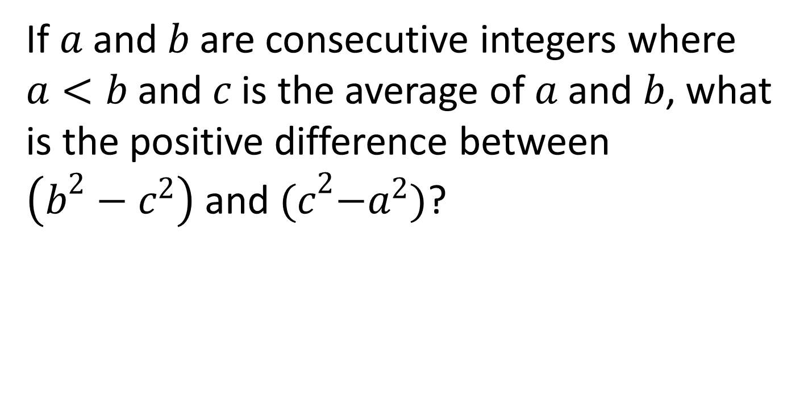
Problem 8
If $a$ and $b$ are consecutive integers where $a<b$ and $c$ is the average of $a$ and $b$, what is the positive difference between $\left(b^{2}−c^{2}\right)$ and${ (c}^{2}−a^{2})$?

Slide 10
Problem 9
What is the probability that two randomly selected points on the edge of a unit circle are less than 1 unit apart?

Slide 11
Problem 10
Express 0.414141414141…₅ as a base 10 fraction in lowest terms.

Slide 12
Extra Problem
(only if needed)
The sum of the length, width, and height of a rectangular prism is 13, and the square of the length of the space diagonal is 65. Find the volume of the prism.

