Slide 1
High School Elimination Tournament
Round 4
5th Annual WSMA Math Bowl
March 7th, 2015
This test material is copyright © 2015 by the Washington Student Math Association and may not be distributed or reproduced other than for nonprofit educational purposes without the expressed written permission of WSMA. www.wastudentmath.org.

Slide 2
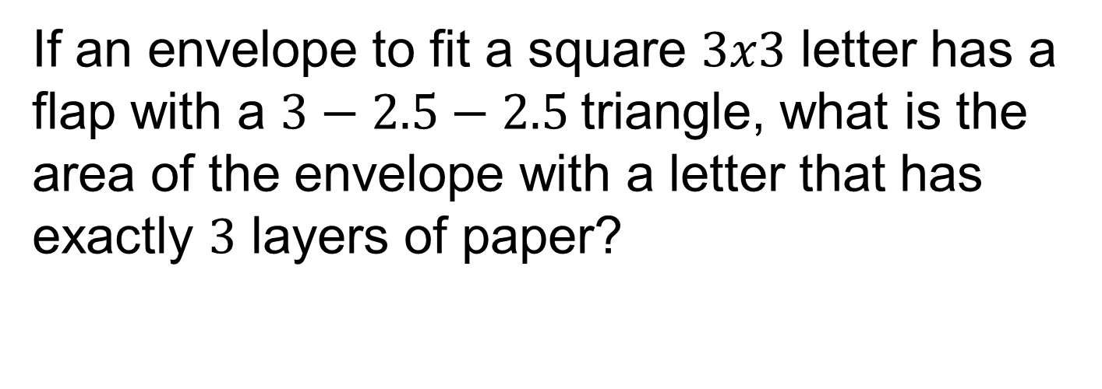
Problem 1
If an envelope to fit a square $3x3$ letter has a flap with a $3−2.5−2.5$triangle, what is the area of the envelope with a letter that has exactly $3$ layers of paper?
Copyright © 2015 by the Washington Student Math Association

Slide 3
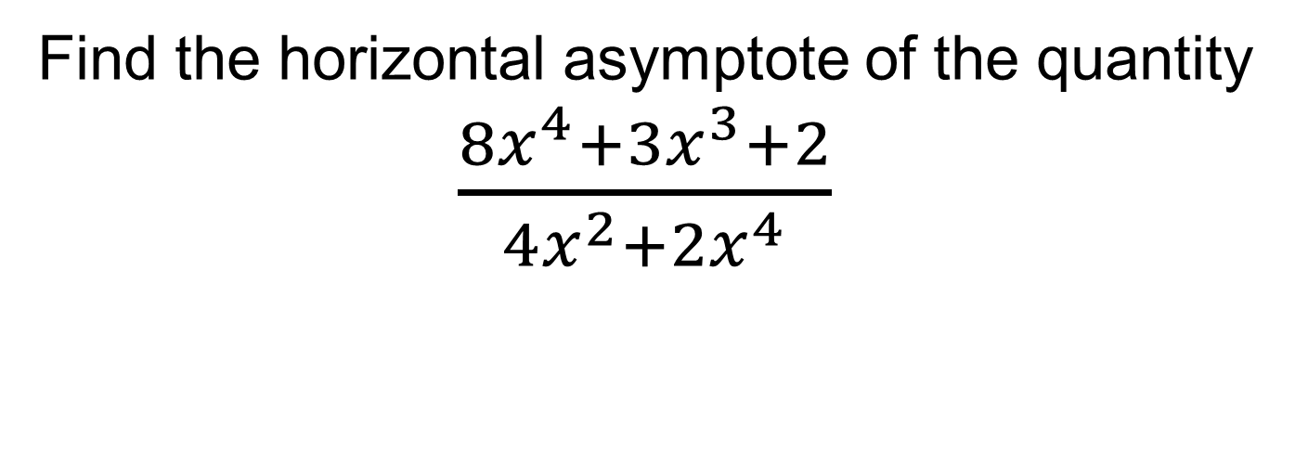
Problem 2
Find the horizontal asymptote of the quantity $\frac{8x^{4}+3x^{3}+2}{4x^{2}+2x^{4}}$
Copyright © 2015 by the Washington Student Math Association

Slide 4
Problem 3
What is the probability of a person flipping a fair coin 5 times and getting exactly 2 tails?
Copyright © 2015 by the Washington Student Math Association

Slide 5
Problem 4
5 friends decide to meet at Jake’s Cafe in Seattle. However, there are five different Jake’s Cafe locations in Seattle and they never agreed to meet at which cafe, so they all choose one at random. What is the probability that they all end up at different Jake’s?
Copyright © 2015 by the Washington Student Math Association

Slide 6

Problem 5
Find the value of ${\left(\sqrt{2}−\sqrt{3}\right)}^{2}$
Copyright © 2015 by the Washington Student Math Association

Slide 7
Problem 6
Here is a pattern: ABBCCCDDDDEEEEE… and the pattern repeats after Z is written 26 times. What is the 354th letter?
Copyright © 2015 by the Washington Student Math Association

Slide 8
Problem 7
What is the sum of the digits of the value
$2^{20} × 5^{15}$?
Copyright © 2015 by the Washington Student Math Association

Slide 9
Extra Question
Steven is mixing solution A which has a concentration of 8% and solution B which has a concentration of 13% in order to produce 1L of solution C with concentration of 10%. Find the volume of solution B needed for this process in liters.
Copyright © 2015 by the Washington Student Math Association

