Slide 1
High School Elimination Tournament
Round 3
5th Annual WSMA Math Bowl
March 7th, 2015
This test material is copyright © 2015 by the Washington Student Math Association and may not be distributed or reproduced other than for nonprofit educational purposes without the expressed written permission of WSMA. www.wastudentmath.org.

Slide 2
Problem 1
How many positive integers $A$ make$logA2401$a positive integer?
Copyright © 2015 by the Washington Student Math Association

Slide 3
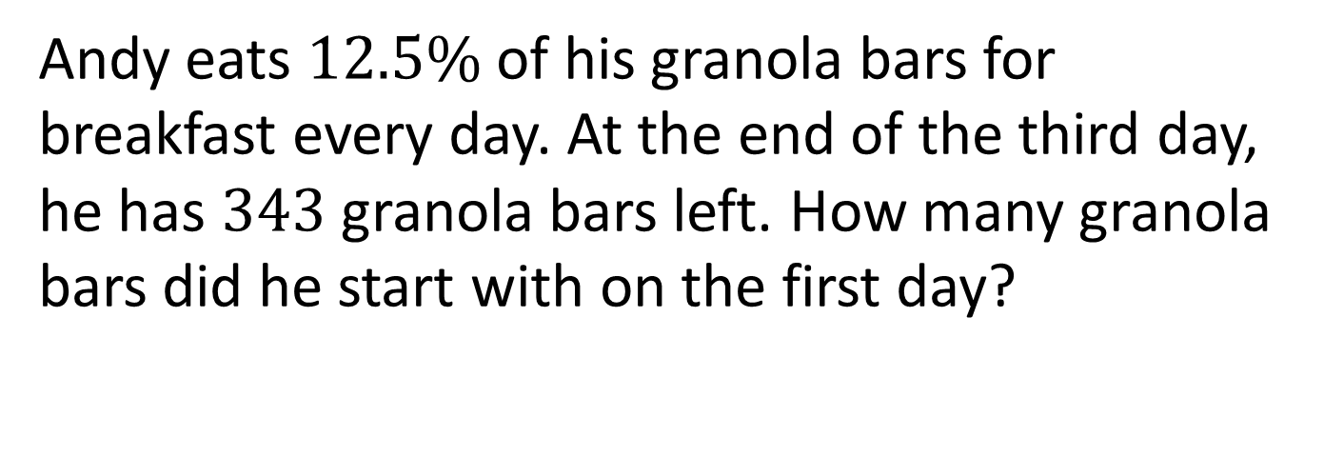
Problem 2
Andy eats $12.5\%$of his granola bars for breakfast every day. At the end of the third day, he has $343$ granola bars left. How many granola bars did he start with on the first day?
Copyright © 2015 by the Washington Student Math Association

Slide 4
Problem 3
What is the value of $sin289+cos289+sin288+cos288+sin287+cos287+sin286+cos286?$
Copyright © 2015 by the Washington Student Math Association

Slide 5
Problem 4
Imagine the line segment that goes from ($−3,4)$to $(3,4).$If the line segment is rotated around the $x$-axis a full $360$ degrees, find the volume of the resulting solid formed in terms of pi.
Copyright © 2015 by the Washington Student Math Association

Slide 6

Problem 5
Find the sum of every integer $x$ that satisfies:
$x^{3}+3x^{2}−10x−24$.
Copyright © 2015 by the Washington Student Math Association

Slide 7

Problem 6
Evaluate:
$$\frac{7+\frac{7+\frac{7+\frac{7+···}{4}}{4}}{4}}{4}$$
Copyright © 2015 by the Washington Student Math Association

Slide 8
Problem 7
What is the sum of the perfect squares between $100$ and $200$ inclusive?
Copyright © 2015 by the Washington Student Math Association

Slide 9
Extra Question
What is the positive difference in length between the longest line that can fit in a 1 inch by 1 inch by 1 inch cube and the longest line that can fit in a 1 inch by 1 inch square?
Copyright © 2015 by the Washington Student Math Association

